Slide 1

Color theory and harmony
Quick guide for photographers

Slide 2
Color theory
We can talk about color using two kinds of terminology:
Color generation systems.
Color harmony system.
Graphic artists and photographers certainly have to understand color harmony. Some of that is intuitive. As for color generation, that’s technical, and based on physics.

Slide 3
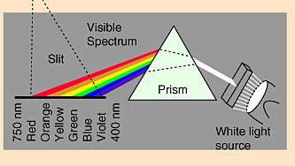
Color theory
Color, of course, is simply visible wavelengths from the electromagnetic spectrum.
Also part of the spectrum is infrared, ultraviolet, radio waves and x-rays.
Black is not a color. Black is the absence of light, obviously! But historically people really did think black was a color. Experiments in physics proved that to be false.
Black nevertheless has strong visual weight in an image or design.

Slide 4

Color theory
If you add all the visible wavelengths together, you get white light. We can prove this obviously by using a prism; a prism separates white light into wavelengths.
A rainbow is simply a prism of raindrops separating sunlight into wavelengths.

Slide 5
Color theory
As we have noted before, “white” light actually usually has a slight color cast. This is due to either the color temperature of the source, or the wavelengths missing.
Higher temperature light is bluer. Lower temperature is redder. This is expressed in color temperature, using the Kelvin scale.

Slide 6

Color theory
This photo shows three different color temperatures: the sunlight through the window is highest; the incandescent light shining on the figures is warmer; the fire is warmest, or lowest, color temperature.

Slide 7
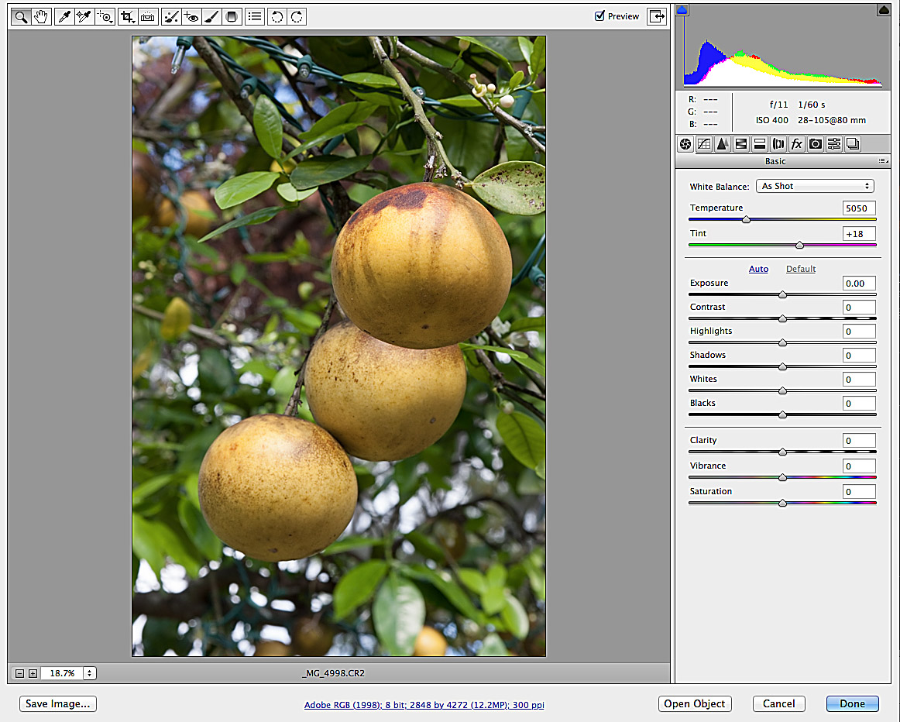

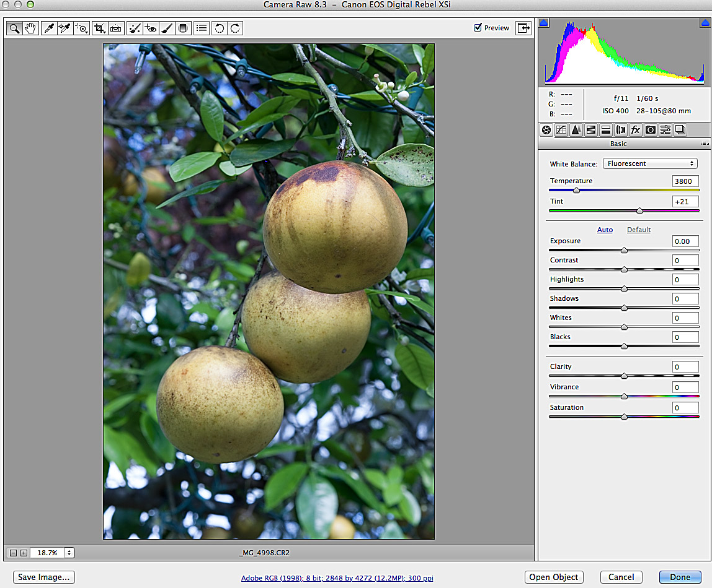
Color theory
You can see the effect of different Kelvin temperatures editing in Photoshop’s Camera Raw. Below we have color balance at, 5,050 degrees K, 6,500 K, and 3,800 degrees K.

Slide 8
Color theory
In addition to color cast, photographers need to understand how color is generated by machines we use, such as computers, televisions, and printing presses.
We generate colors in two ways:
The additive system.
The subtractive system.

Slide 9
Color theory
The additive system begins with the absence of color, that is, black, and adds colors to that to reach the color we want.
It is based on three additive primaries: red, green, and blue (RGB system).
Additive color is used in projected systems, such as televisions and computer monitors, and movies.

Slide 10

Color theory
Consider the computer monitor. A monitor projects color based on three “guns” of variable voltage: one each for R, G and B. The more intense the voltage, the more intense the color projected.
These voltages are expressed in numbers from 0 (black, no color), to 255 (most intense color).
Voltages are projected as phosphor (light sensitive) dots on a screen. Check out a computer screen with a magnifying glass; you’ll see it’s actually made of square dots, called picture elements, or pixels.

Slide 11
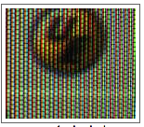
Color theory
Obviously, 0, 0, and 0 voltage will produce black, while 255, 255, and 255 will produce white.
Other colors depend on a combination of intensities of RGB.
Keep in mind the color is not actually mixed on the screen. It is either on or off, based on bits, color or no color.
Each pixel has a certain number of bits that can display a color.

Slide 12
Color theory
Most modern computer monitors can transmit “true color,” or 24-bit color. This means each “channel” (R, G, or B) contains 8 bits per channel that can transmit color.
Eight bits means the channel can make eight combinations of on or off of the color, per pixel, 256 colors total. You have three channels. How many colors can be generated?
256 x 256 x 256=16,777,216 possible colors.

Slide 13


Color theory
Eight-bit color also exists, 256 colors total. These are called “web-safe” colors, because they are sure to render accurately on anyone’s monitor. Nowadays we don’t have to worry about that as much. (Below: 8-bit vs. 24-bit color.)

Slide 14
Color theory
You also can have 32-bit color, even 48-bit color. The last one has 281 trillion colors, far more than the eye can discern. But it is useful in some printing techniques, or so I’ve read.
Additive color is really handy in projected applications. But it doesn’t work in printed applications, that is, ink on paper.

Slide 15
Color theory
Additive color won’t work for printing because we can’t begin with black. We must begin with a piece of paper, and that’s usually white.
White, as we know, is all colors. So we can’t add to all colors. We must subtract.
Furthermore, an offset printing press can’t generate the enormous number of colors available on a computer screen. We need to run a piece of paper through the press for each ink.

Slide 16
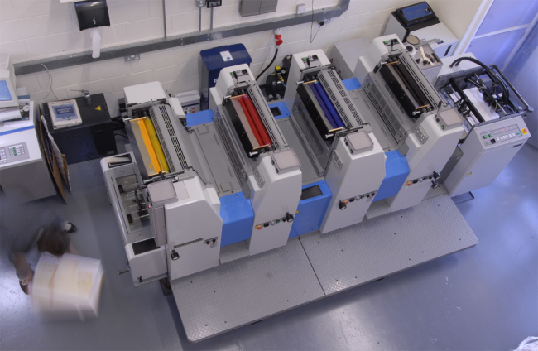
Color theory
The press below has four heads, one for each ink in the CMYK system.

Slide 17
Color theory
Printed color, therefore, is based on the subtractive system. While the additive primaries (used to generate all colors ) are RGB, beginning with black…
…the subtractive primaries are Cyan, Magenta, Yellow and Black (CMYK), and begin with white.
Cyan=blue-green. Magenta=red-blue. Yellow=red-green.
Note the relationship between the additive and subtractive primaries.

Slide 18
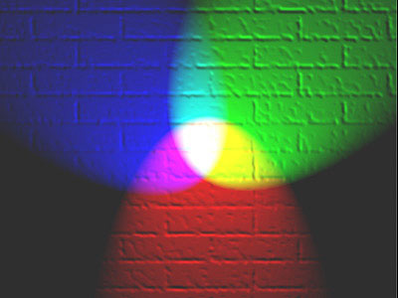
Color theory
You can actually project the additive colors to produce the subtractive.

Slide 19
Color theory
Subtractive primaries are based on ink colors of CMYK. Black is abbreviated “K” by tradition, perhaps because it is the “key” color. In color printing, you need black to make the other colors vibrant and snappy.
This is why the subtractive process is also called the four-color process, producing color separations, or “seps.” Colors used are called the process colors.

Slide 20
Color theory
Note that in effect the ink in the subtractive system acts like a filter, beginning with the white paper, all colors. So if you place cyan ink and magenta ink over the paper, what do you get?
Cyan=green and blue, so transmits those colors, and absorbs red.
Magenta=red and blue, so transmits those colors, and absorbs green. But red has already been absorbed by the cyan, so the only color left to transmit is blue.
Result: blue.

Slide 21
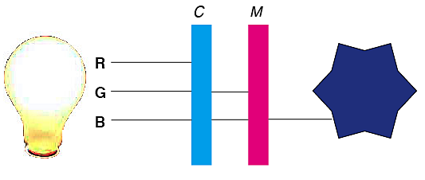
Color theory

Slide 22
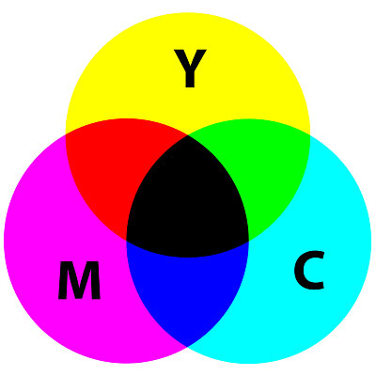
Color theory
Question: You combine magenta ink and yellow ink. What color do you get? Magenta=R and B, Yellow=R and G.
Question: You combine yellow and cyan ink. What color do you get? Yellow=R and G, Cyan=G and B.

Slide 23
Color theory
Question: you combine cyan, magenta, and yellow ink. What do you get? A muddy brown. Inks are not pure, and it is impossible to get a good black by mixing them, hence the addition of black in the CMYK system.
Printers use the four-color system, called process colors, as a way to avoid using a spot color for each color specified by the illustration. With only four colors, CMYK, we can generate all colors.

Slide 24
Color theory
The process color system does not actually “mix” the colors on a page, one atop the next. Instead the colors are deposited overlapping each other, in an pattern at a precise angle. We mix the colors in our mind to see the desired color.
In this way, each color forms a dot, similar to the half-tone process used for black and white “continuous tone” (contone) generation, as for photos.

Slide 25
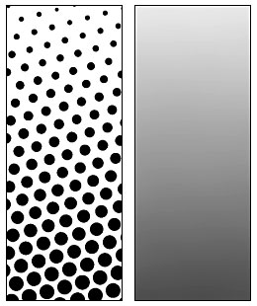
Color theory
Here we can see a close-up of a halftone pattern. Note the closer the dots, the more overlap, and the darker the color. From farther away, it looks like gray.

Slide 26
Color theory
Four-color separations and halftones are printed by screening them into dots. The smaller the dots, the finer the resolution. This is expressed in dpi, dots per inch.
Similarly resolution on computers is expressed in ppi, pixels per inch. The two are related.
Generally, we need to save photos as double the ppi of the dpi specified.

Slide 27
Color theory
For example, many magazine-quality publications require about 133 dpi, called a 133-line screen. This means photos need to be saved at a resolution of 266 ppi to be of acceptable quality.
Publications on newsprint or other low quality stock are printed at 55- or 65-line screens to avoid dot gain. This is why they don’t look as high quality as those in magazines.
“Dot gain” means that as the ink soaks into low quality paper, it gets bigger, giving the photo a muddy look.

Slide 28

Color theory
Ink must soak into lower-quality paper to allow it to dry quickly, because newspapers are quickly printed and distributed within hours.
Magazines often are printed on coated stock (shiny paper) that does not allow ink to soak in. Instead it dries more slowly by oxidation. This keeps fine details sharp, but a printer has to let the publication dry before it can be distributed.
Consider the color dot pattern at left; the higher the dot gain, the more likely fine details will become muddy.

Slide 29
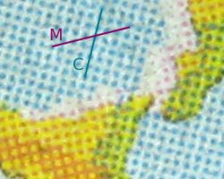
Color theory
This close-up shows a process color screening process. Note cyan atop yellow appears as green. Magenta on yellow appears (orangish) red.

Slide 30
Color theory
Color separations on a typical offset press must be created and printed with a high degree of accuracy to produce a quality printed product. This requires skilled printers.
Recall that a piece of paper must be run through an offset press four times to print process color: once for each process ink, plus black.
If the paper is run through at a slightly different angle, the colors won’t overlap properly. A color ghost may be seen on an edge, and colors will be muddy. This is called “out of registration.”

Slide 31
Color theory
Registration problems are particularly common in publications printed and distributed quickly, such as newspapers.
In magazines and quality publications, photographers may prefer to see proof copies of color separations, to check color quality.
They may also prefer to go to the printers at the beginning of a run, to check color quality off the press.

Slide 32

Out of registration
Amajor registration problem from a recent issue of the Minneapolis Star-Tribune outstate edition. It was probably fixed by the time the metro edition appeared.

Slide 33
Color theory
We said color theory can be related to color generation system or color harmony. Color harmony may be considered by three properties:
Hue.
Value.
Saturation.

Slide 34
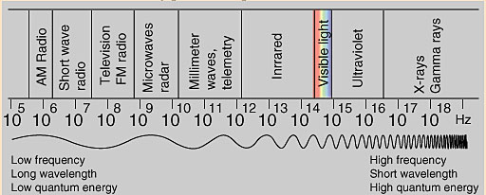
Color theory
Hue is the name of the color, determined by the wavelength of the electromagnetic spectrum.
The Munsell color wheel sets up five primary hues: red, yellow, green blue and purple.

Slide 35
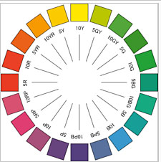
Color theory
Value is the degree of lightness or darkness of a color. In paint, we mix black to darken a color, called a shade, and white to lighten a color, called a tint. Photographers also call this tone.
Saturation, or intensity, is a measure of the color’s perceived purity or brightness. Munsell called this chroma.

Slide 36
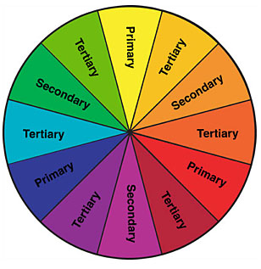
Color theory
We can choose color harmony based on complementary colors on a color wheel.
A color wheel can guide color choice as described in this YouTube video. [http://www.youtube.com/watch?v=59QGexKdFUI]

Slide 37


Color theory
Some general guidelines for choosing color:
Differences will be emphasized. For example, yellow surrounded by green will tend to appear more yellow; green surrounded by yellow it will tend to appear more green. This is the rule of simultaneous contrast.

Slide 38

Color theory
Warm colors appear to advance; cool colors appear to recede. We can use this perception to add a feeling of dimension.

Slide 39
Color theory
Reds tend to dominate in a design.
Research shows the favorite color of most Americans is blue.
Green in America is associated with bitterness; brown is associated with maleness. This means, for example, that sugar will tend not to sell in a green package, and women’s cosmetics will tend not to sell in a brown package.

Slide 40
Color theory
When choosing spot colors, graphic artists may:
Consider a spot color for graphic or clip art.
Consider a spot color for all headlines, subheads, drop caps, etc.
Create screened backgrounds using a spot color.
Keep a publication unified by choosing a single color for all headlines, drop caps, etc. An artist can screen the color (make it lighter) for variety.

Slide 41
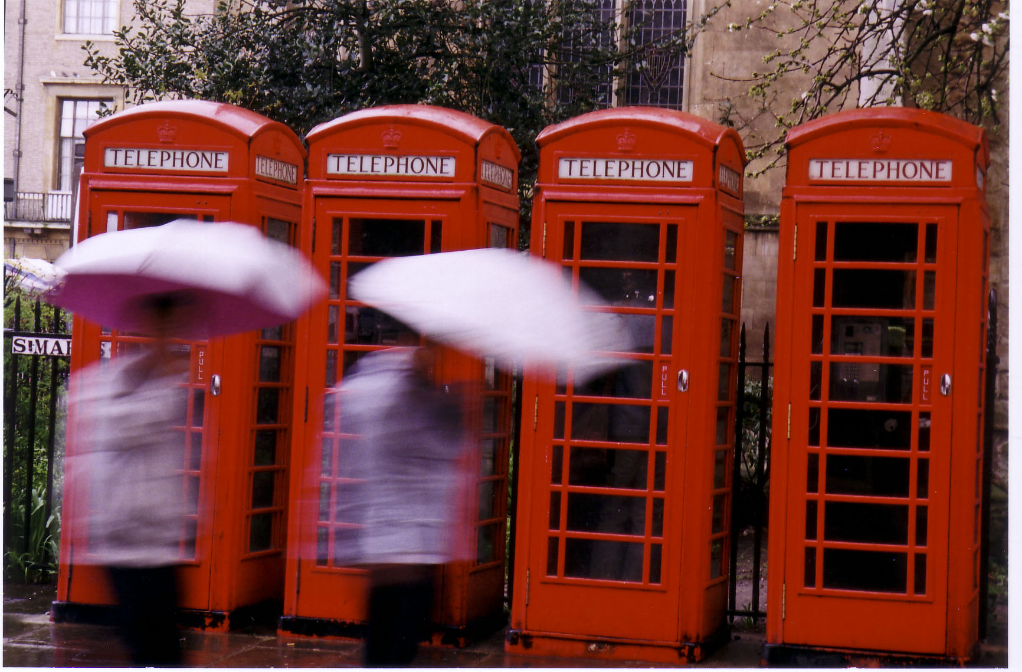
Color in photography
Photographers may choose color harmony or contrast to enhance a center of interest or aid other tools of composition.

Slide 42

Color in photography
Often photographers choose what artists call a limited palette—a few colors that harmonize, instead of many.

Slide 43

Color in photography
Black may not be a color, but it can be effective when combined with colors.

Slide 44

Color in photography
Strongly contrasting foreground and background colors can emphasize a center of interest.

Slide 45

Color in photography
Warm light of sunrise or sunset can help to harmonize clashing hues.

Slide 46

Color in photography
Nature often provides natural color harmony.

Slide 47
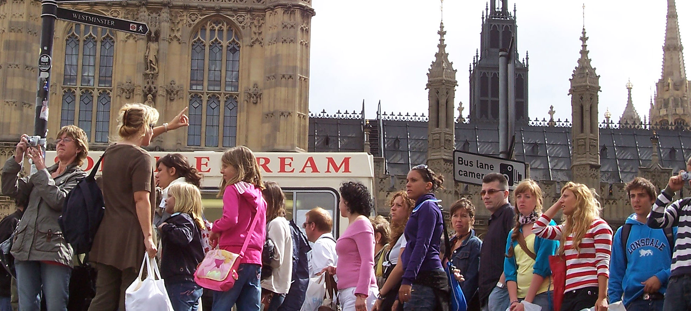
Color in photography
Lots of colors together may compete, and not harmonize. Yet it’s difficult for photojournalists to find color harmony in street photography.

